Slide 1

Security & Privacy training
ELBEZ HAMMOUDA

Slide 2
Agenda
1
Protection on Social media
2
Computer protection
3
Smart phones protection
4
How to act and what to do as a victim
5
Social Engineering, what is it ?
6
Parental Control tools for better monitoring

Slide 3

Introduction
Who is a Hacker ?
A hacker is someone who explores methods for breaching defenses and exploiting weaknesses in a computer system or network.
A hacker is also a person who develope innovative solutions. ( Hackathons etc ).
Types of Hackers
Black Hat : The bad guys.
Grey Hat : It depends on the situation ( either Bad or Good one ).
White Hat : The good guys.

Slide 4

Introduction
Edward Joseph Snowden is an American whistle-blower who copied and leaked highly classified information from the National Security Agency in 2013 when he was a Central Intelligence Agency employee.

Slide 5
Privacy issues

Slide 6
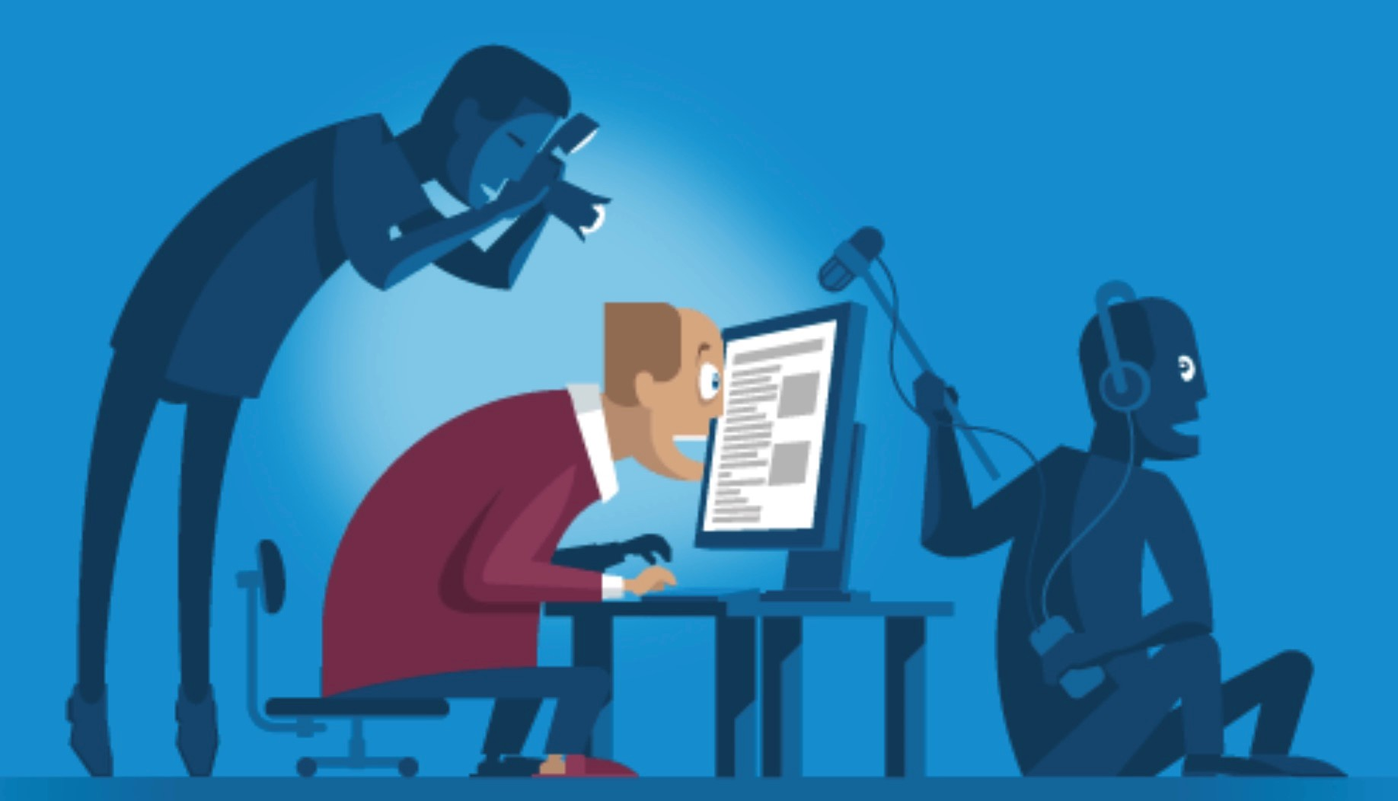
Protection on Social media
Privacy issues

Slide 7
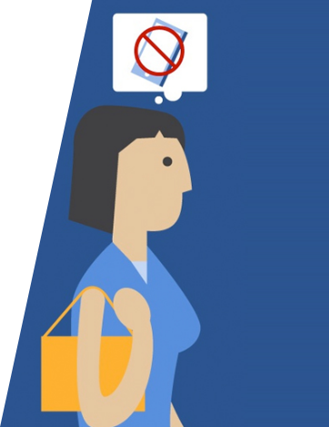


Protection on Social media
Privacy issues
Sharing nothing at all
OverSharing

Slide 8
Protection on Social media

Slide 9
Famous attack vectors

Slide 10
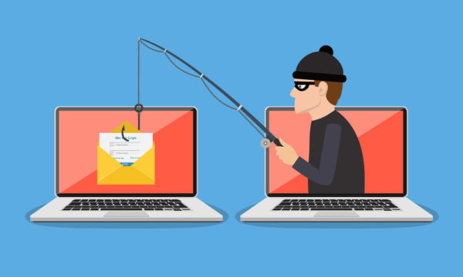
Protection on Social media
Phishing

Slide 11
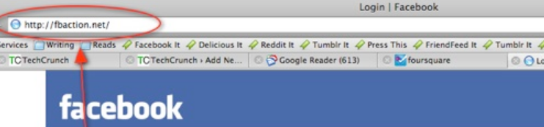
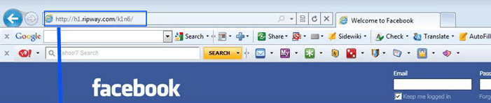
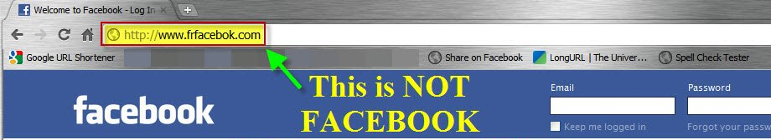
Protection on Social media
Phishing

Slide 12

Protection on Social media
Access Token

Slide 13
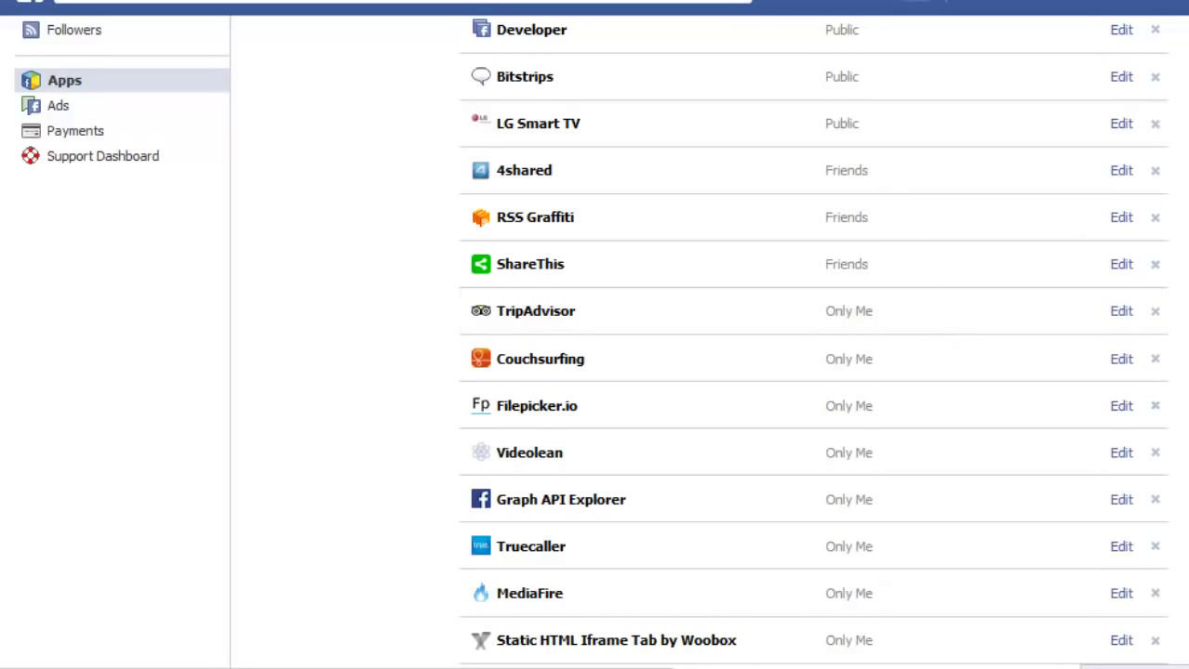
Protection on Social media
Access Token

Slide 14
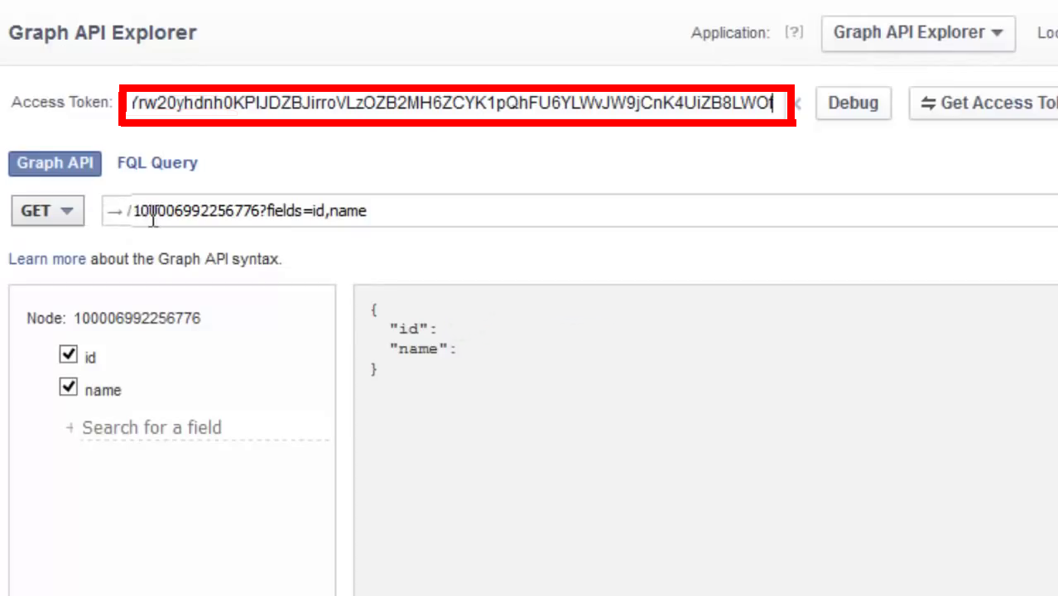
Protection on Social media
Access Token

Slide 15
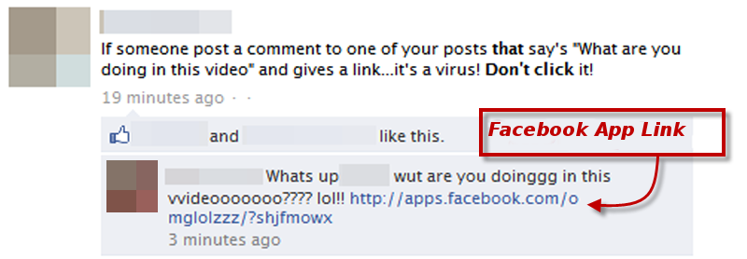
Protection on Social media
Access Token

Slide 16
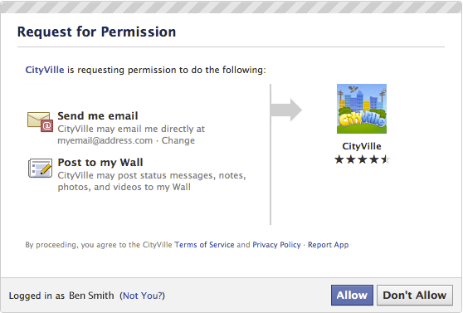
Protection on Social media
Access Token

Slide 17

Protection on Social media
Brute Force

Slide 18
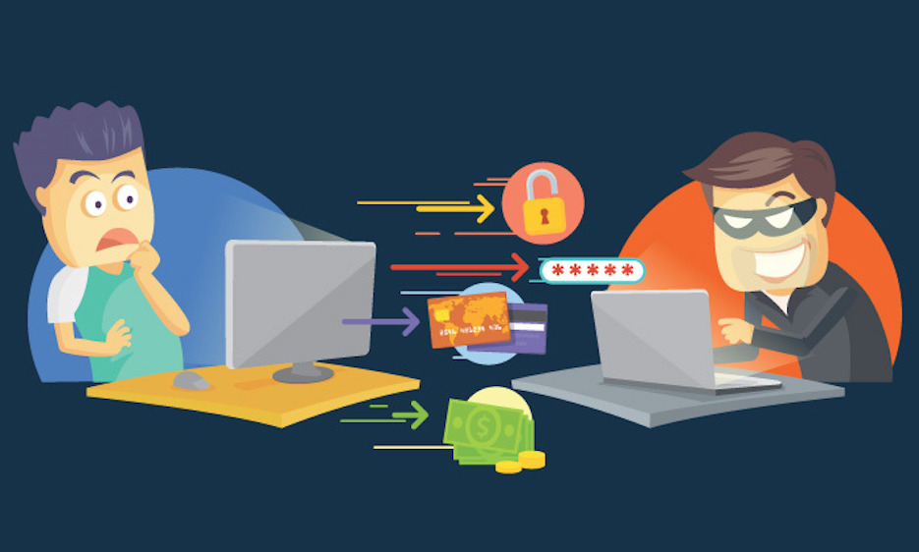
Protection on Social media
Brute Force

Slide 19
How to protect ?

Slide 20
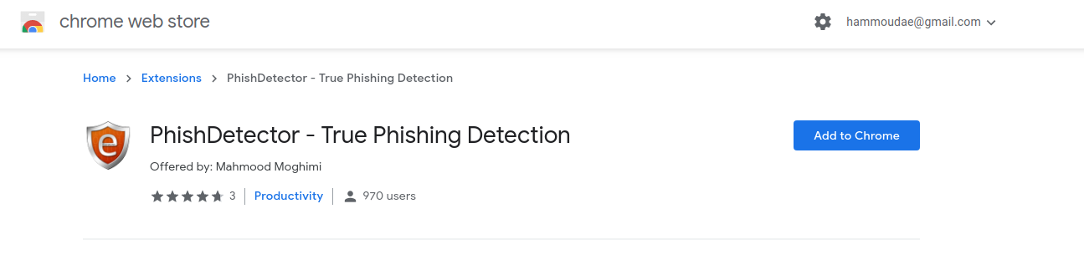
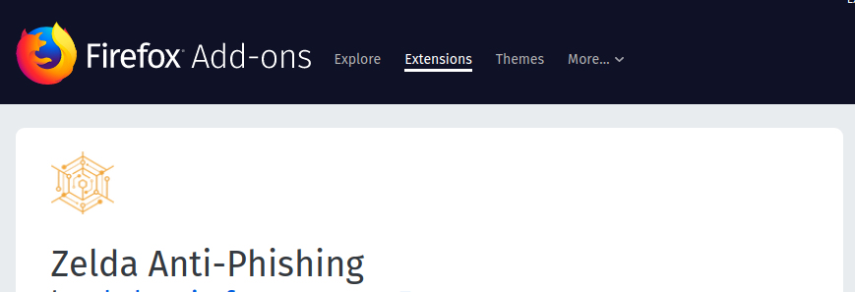
How to protect ?
Web Browser Plugins

Slide 21
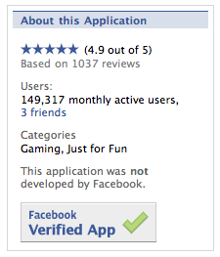
How to protect ?
Always use verified apps on facebook

Slide 22
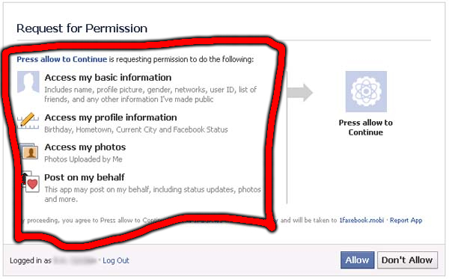
How to protect ?
Have a look at the app permission before accepting it.

Slide 23
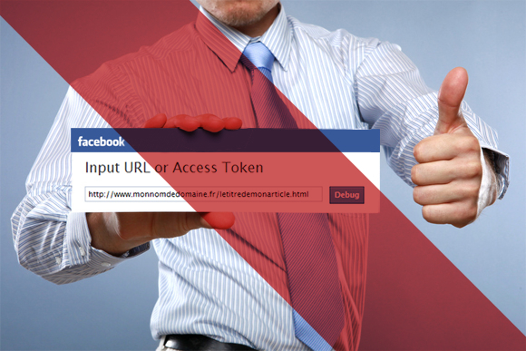
How to protect ?
Don't share your access token with anyone

Slide 24

How to protect ?
Always check for “Https” when browsing the social media or any other website

Slide 25
Computer Protection

Slide 26
Famous attack vectors

Slide 27
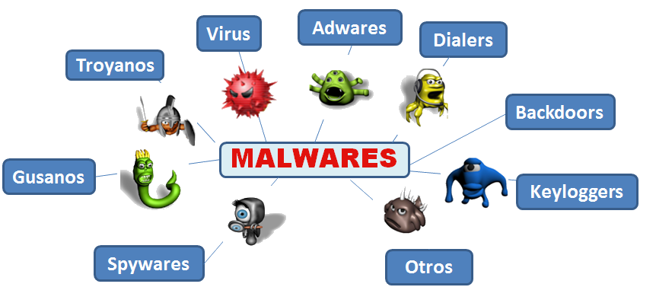
Computer Protection
Malwares
Trojan
Worm
Others

Slide 28
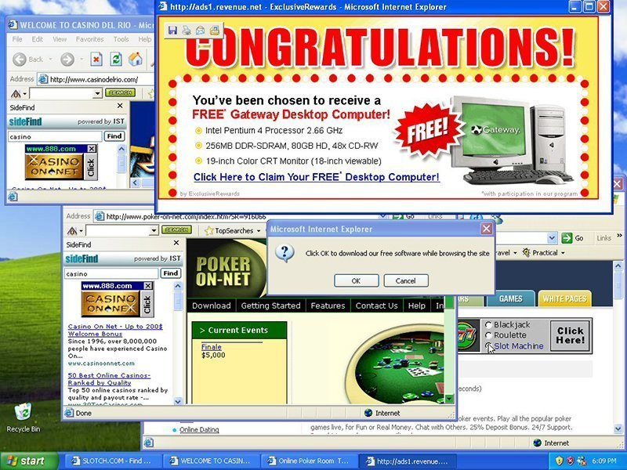
Computer Protection
Adwares

Slide 29
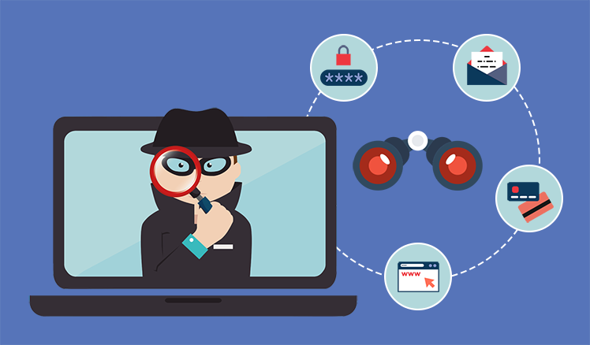
Computer Protection
Spywares

Slide 30

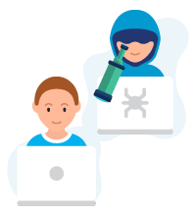
Computer Protection
Keyloggers

Slide 31
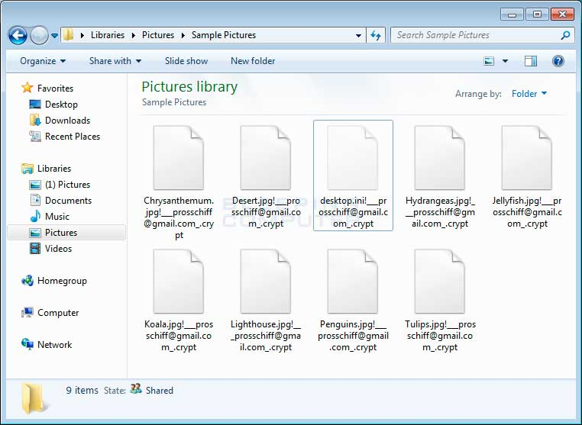
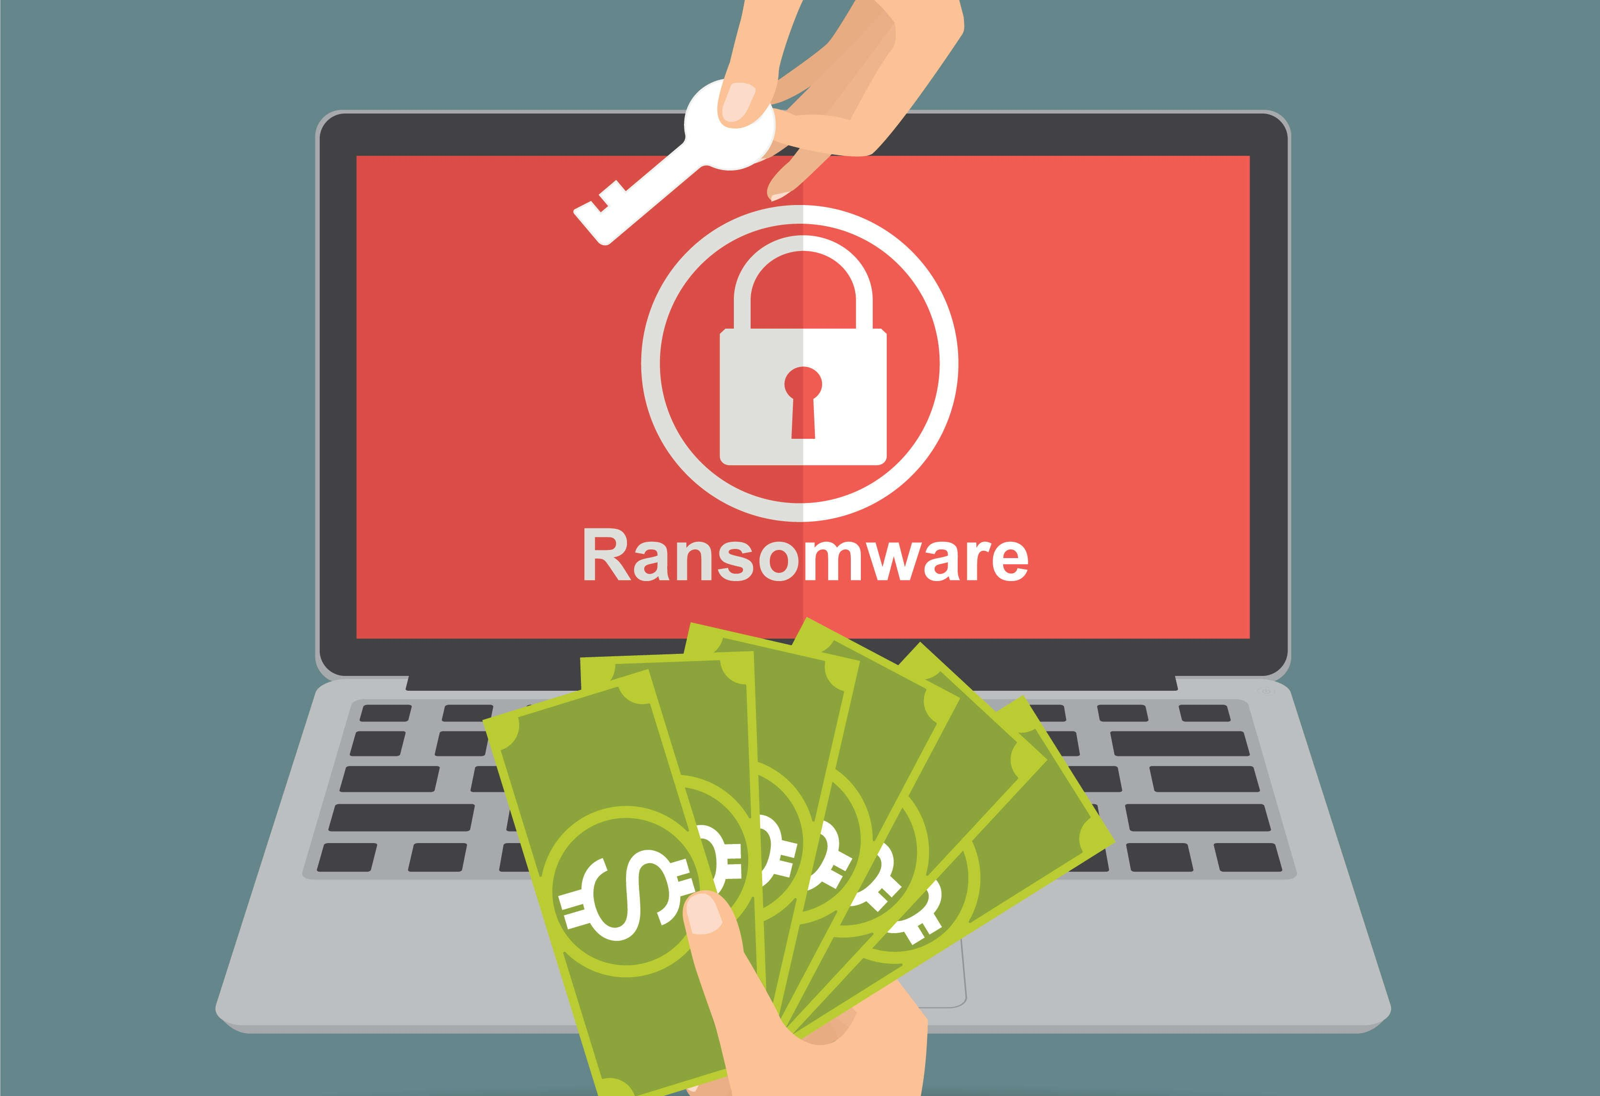
Computer Protection
Ransomware

Slide 32
How to protect ?

Slide 33

How to protect ?
Install Antivirus

Slide 34
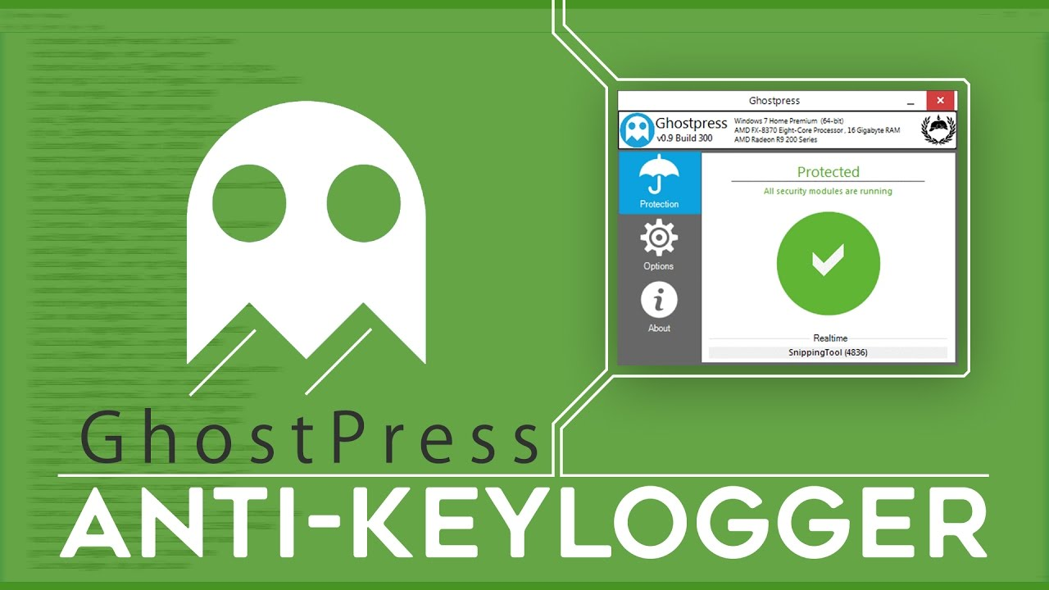
How to protect ?
Anti-keylogger

Slide 35

How to protect ?
Avoid or be extra carefull when dealing with softwares from unknown sources, keygens or cracks
keygens cracks

Slide 36
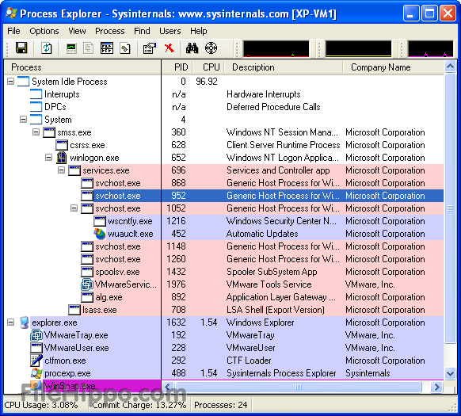

How to protect ?
Use tools to monitor activities in your computer

Slide 37
Smart phones protection

Slide 38


Slide 39

Security

Slide 40
Famous attack vectors

Slide 41
Smart phones protection
Smart phone Malwares
Trojan
Worm
Others

Slide 42


Smart phones protection
Smart phone Malwares, from where ?

Slide 43
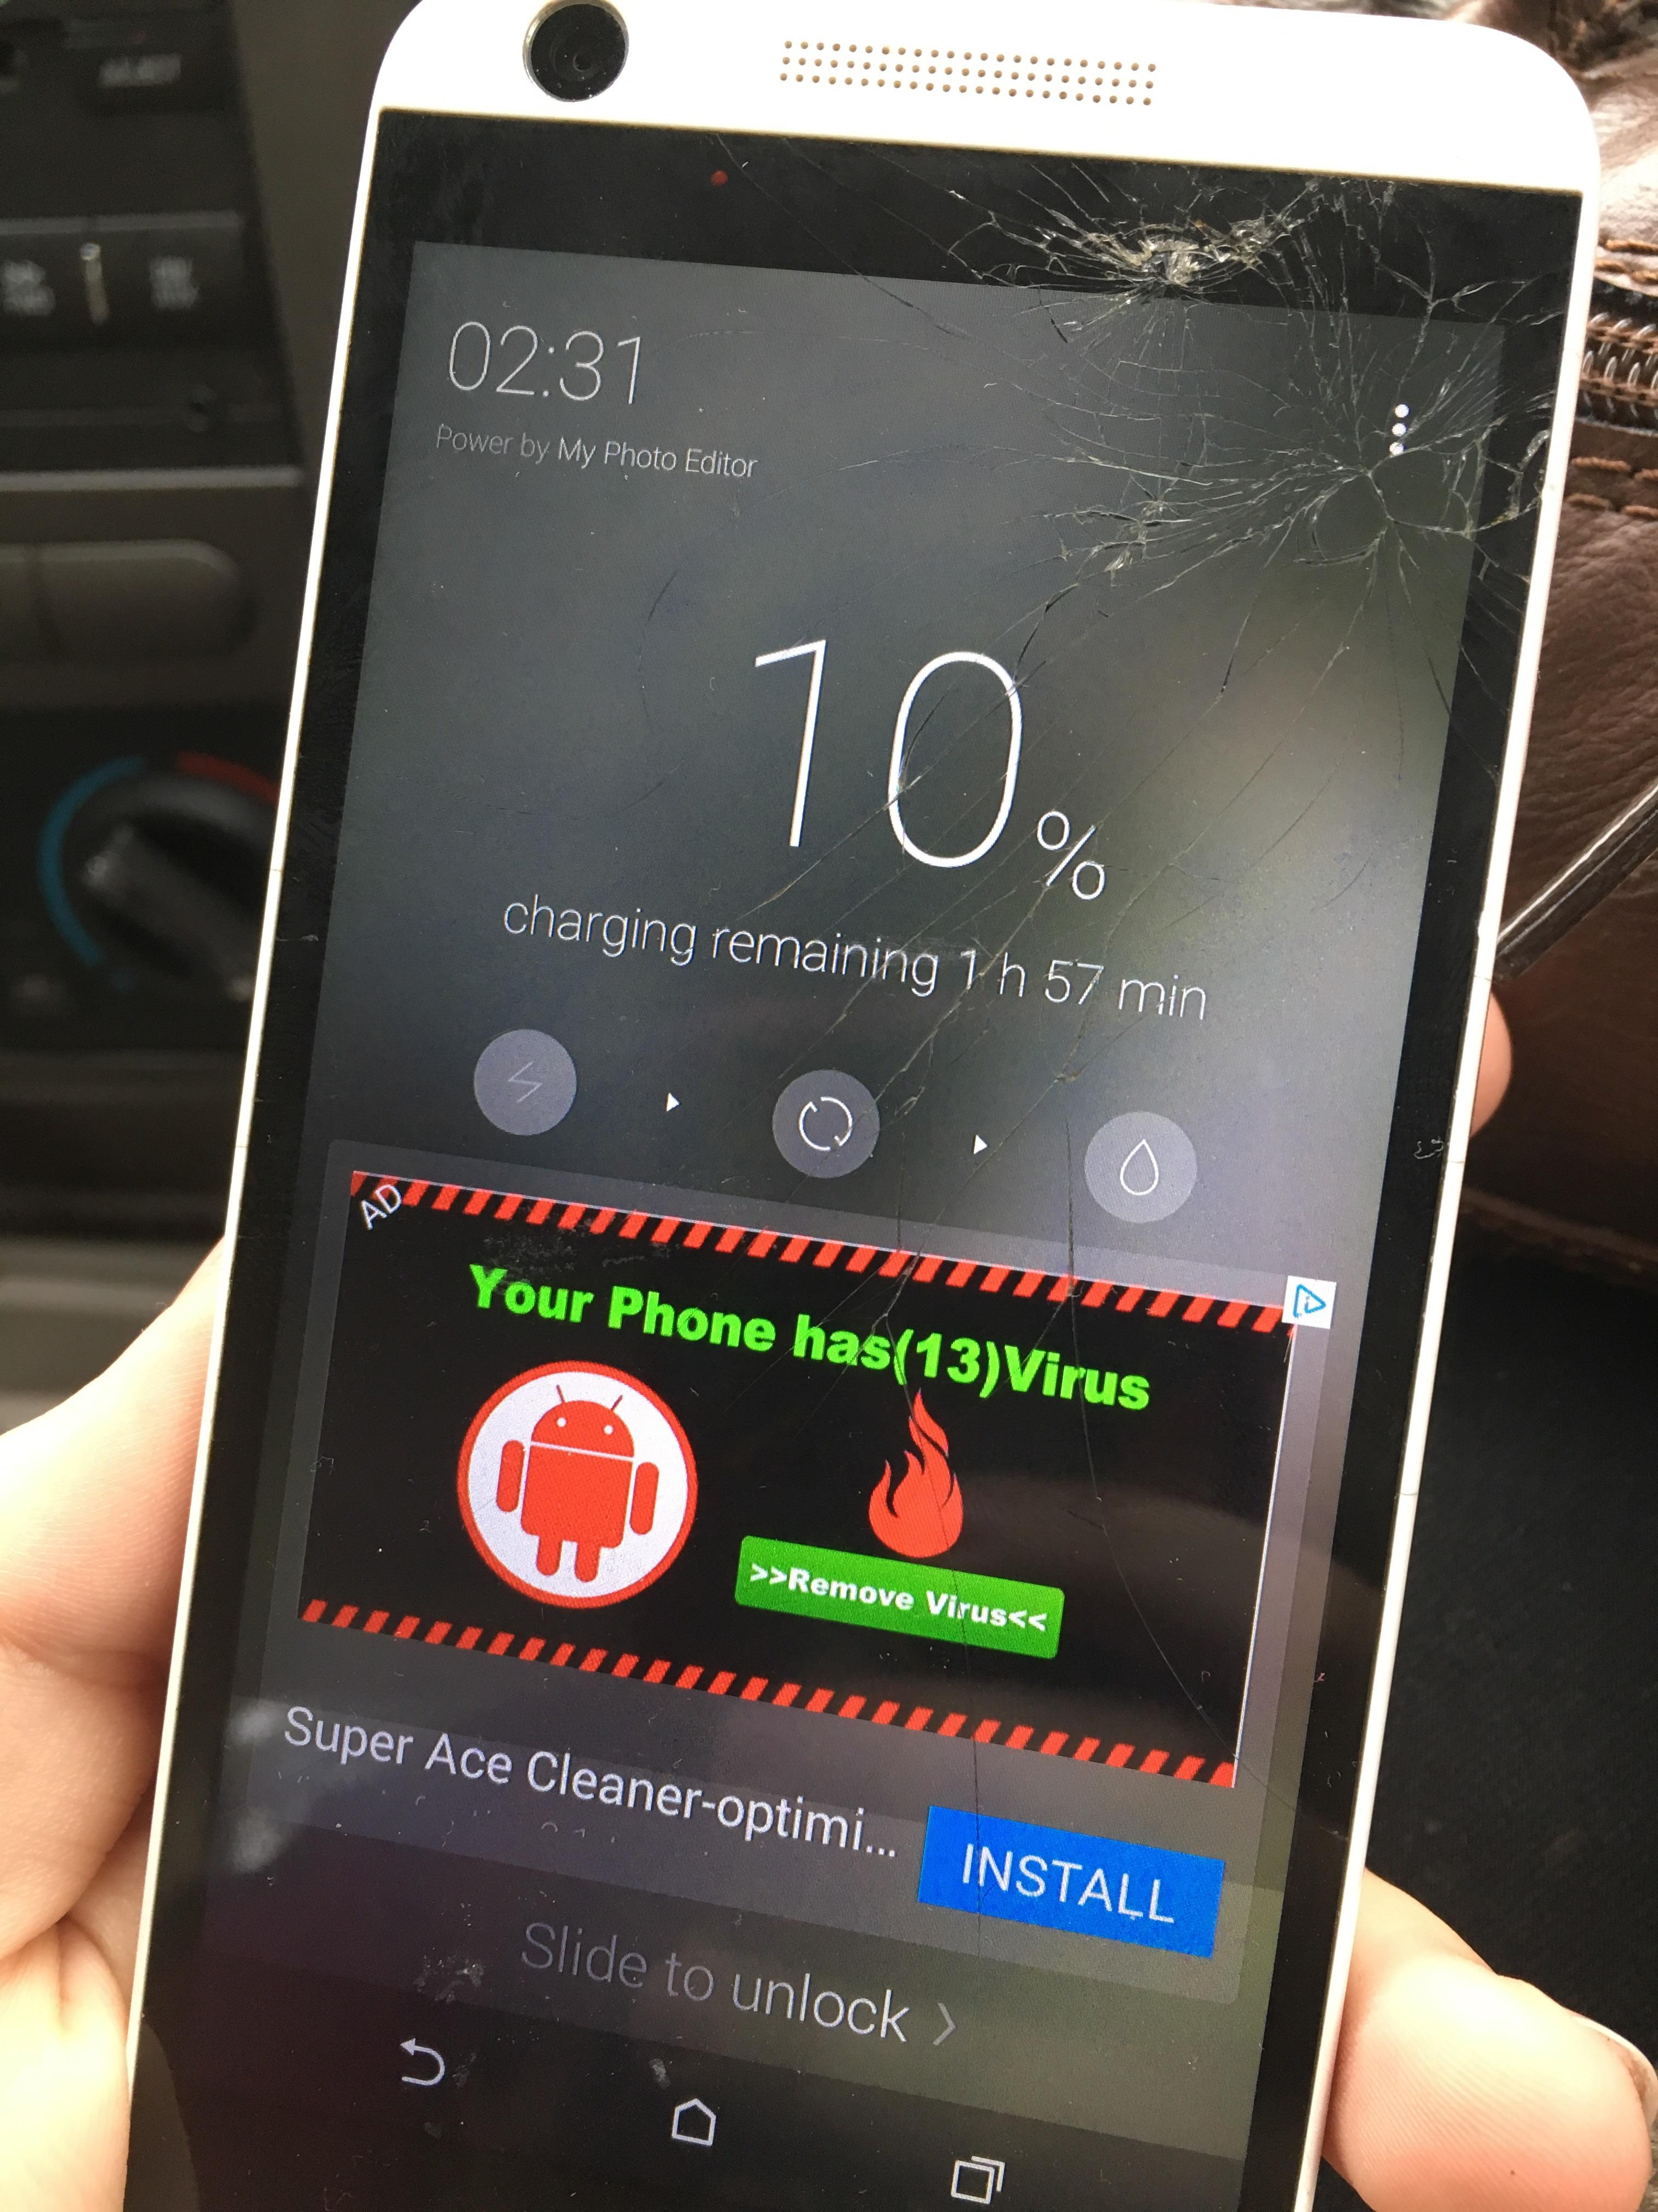
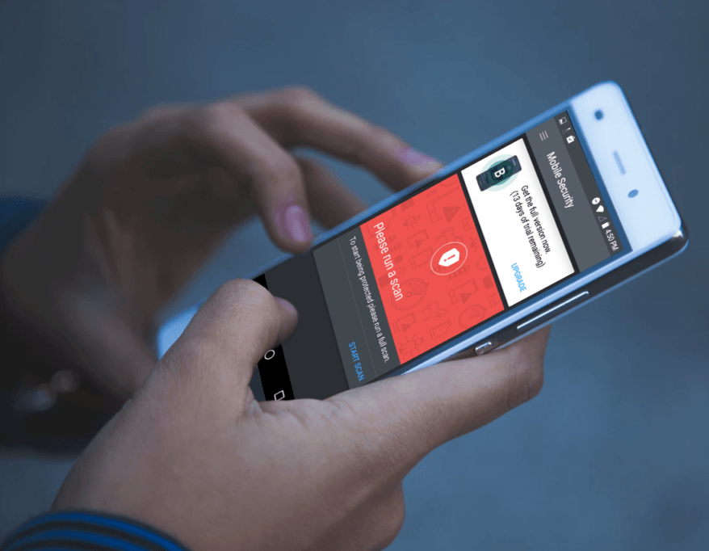
Smart phones protection
Adware

Slide 44
Mobile Root

Slide 45
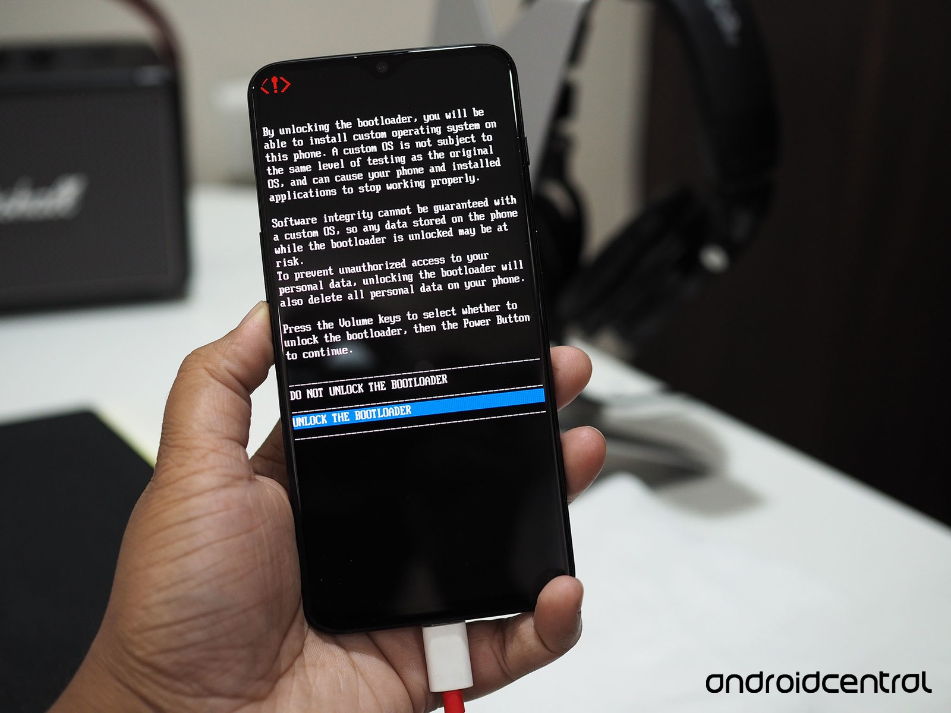

Mobile Root

Slide 46
Mobile Root
Pros
- Full controle of your phone.
- install custom roms.
- install other systems on your phone ( Linux etc).
Cons
- Any virus infection may be critical.
- Wrong use of the phone may cause permanent damage.
- Installing wrong rom may cause a Softbrick or Hardbrick.

Slide 47
How to protect ?

Slide 48
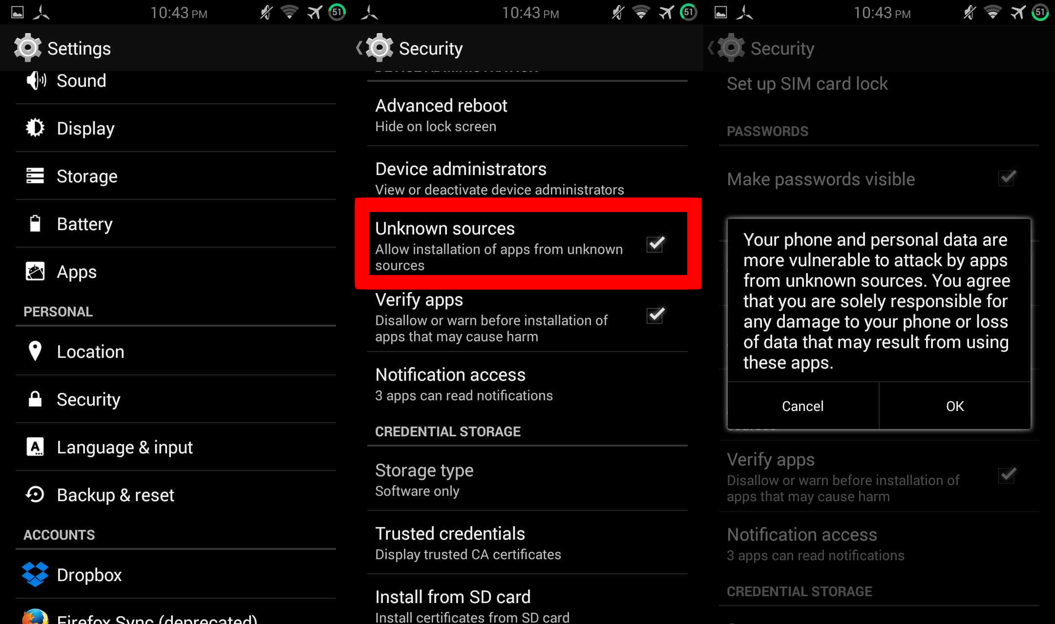
How to protect ?
Avoid installing applications from unknown sources

Slide 49
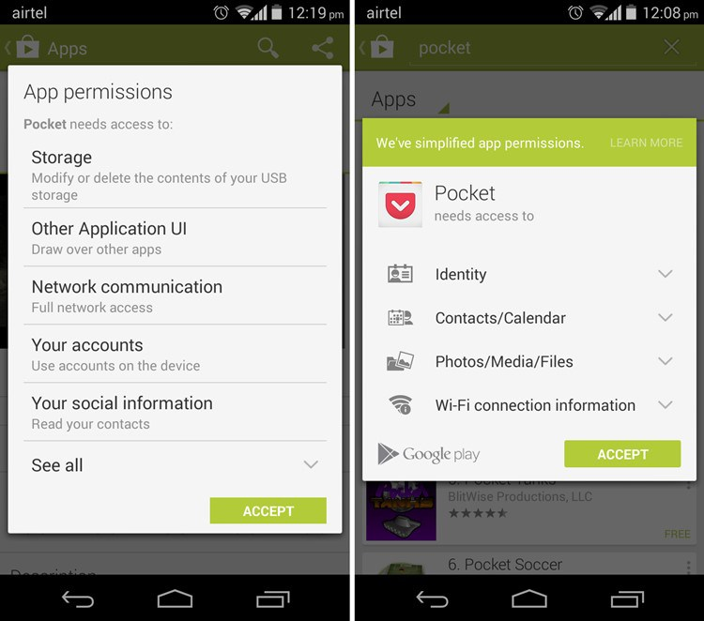
How to protect ?
Always check permissions before installing any appliation

Slide 50
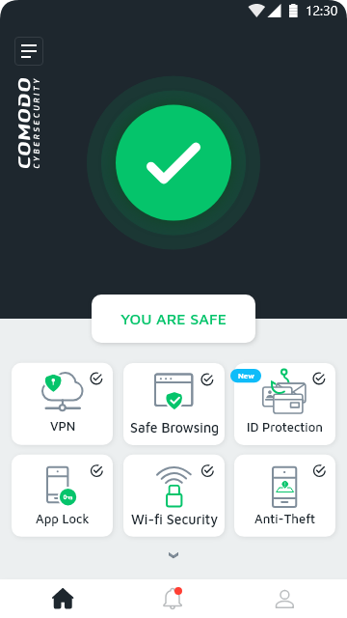
How to protect ?
Mobile antivirus

Slide 51

How to protect ?
Remove any not needed applications

Slide 52
How to act and what to do as a victim ?

Slide 53
How to act and what to do as a victim ?
The computer
Disconnect from the internet. (everyone)
Detect the virus name and location and remove it. (Basic)
Track the virus to the hackers IP adress. (Advanced)
Reverse the hack from your computer to the Hacker's one. (Advanced)
Report to authorities with the computer. (everyone)
Social media
Try to recover it. (Basic)
Report to authorities with any evidances. (everyone)
Mobile phone
Report to authorities with any evidances. (everyone)

Slide 54
Social Engineering, what is it ?

Slide 55
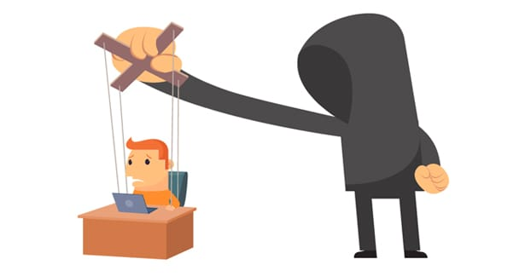
Social Engineering, what is it ?
Social engineering, in the context of information security, refers to psychological manipulation of people into performing actions or divulging confidential information.

Slide 56
Social Engineering, what is it ?
Walmart employee fired for stealing money keeps uniform and steals another $30,000 from three other Walmarts
A 17-year-old male from Oklahoma was fired from his job at Walmart for stealing money. Rather than considering himself lucky that he got away without being charged, he put his uniform back on and stole $30,000 from three other Walmarts by pretending to be a general manager from another store.

Slide 57
Social Engineering, what is it ?
Sony Pictures Hack
The Sony Pictures hack began as an Apple ID phishing email. Several Sony executives received emails that requested they verify their Apple credentials on a phishing page under the control of the attackers. Using the executive’s LinkedIn profiles, the attackers determined their likely login credentials for the Sony network and identified at least one executive who used the same password for both their Apple and Sony accounts. With these credentials, the hackers were able to gain access to Sony Networks, resulting in the theft of a claimed 100 terabytes of sensitive company and employee information.

Slide 58
Social Engineering, what is it ?
Good people don’t do bad things
If you don’t seem like a bad guy, then most people will assume that you’re not, and this is a problem.

Slide 59

Social Engineering, what is it ?

Slide 60
Parental Control tools for better monitoring

Slide 61
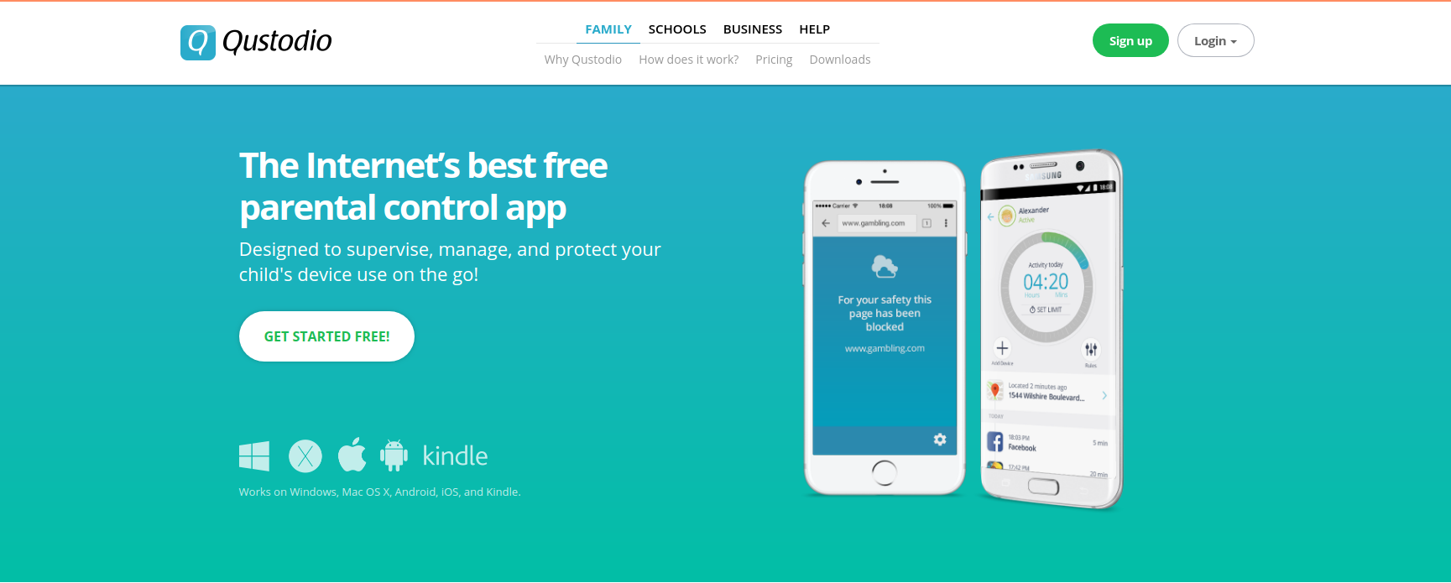
Parental Control tools for better monitoring
Features:
- Filter website content.
- Access real-time location.
- Block social apps.
Pros:
Use time scheduler for internet usage.
Cons:
No gaming control feature.
https://www.qustodio.com

Slide 62
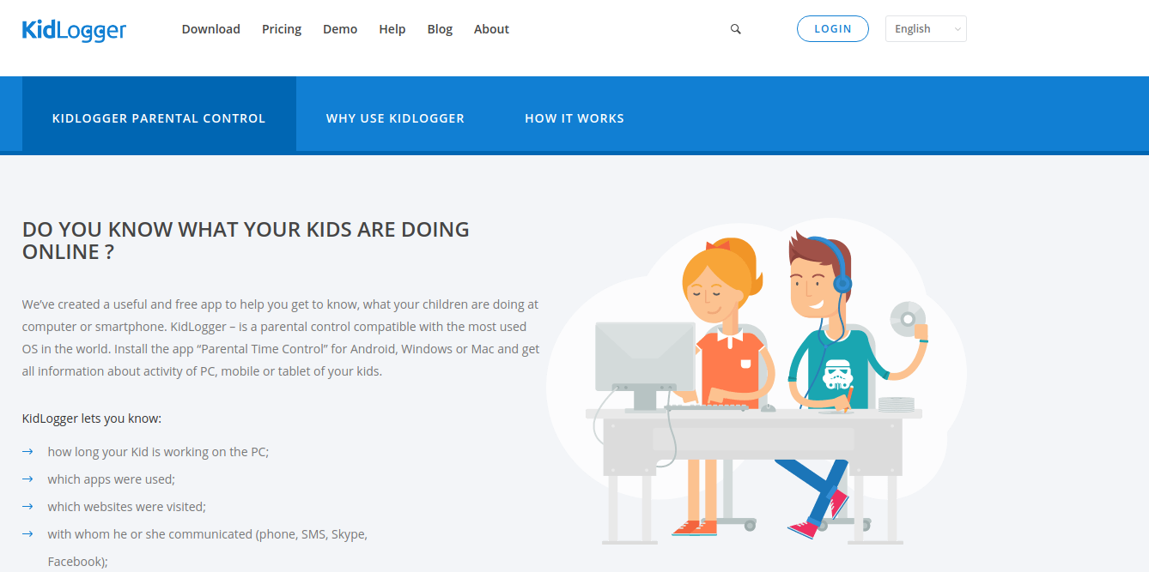
Parental Control tools for better monitoring
Features:
- Monitor Web History
- Take a screenshot of
computer screen.
Pros:
This app is available in free of cost and monitors 5 devices.
Cons:
This app has no time control feature.
https://kidlogger.net

Slide 63


Parental Control tools for better monitoring
FamiSafe
SafeDNS

Slide 64
Questions ?

